Slide 1

Fall 2025
MEMBER
DEMOGRAPHICS
Merged Demographic Surveys Results
Total responses: 4,043 (51% of membership: 7,818)
Notes:
Added 701 responses since Sept. 2024 – up from 45% to 51%

Slide 2

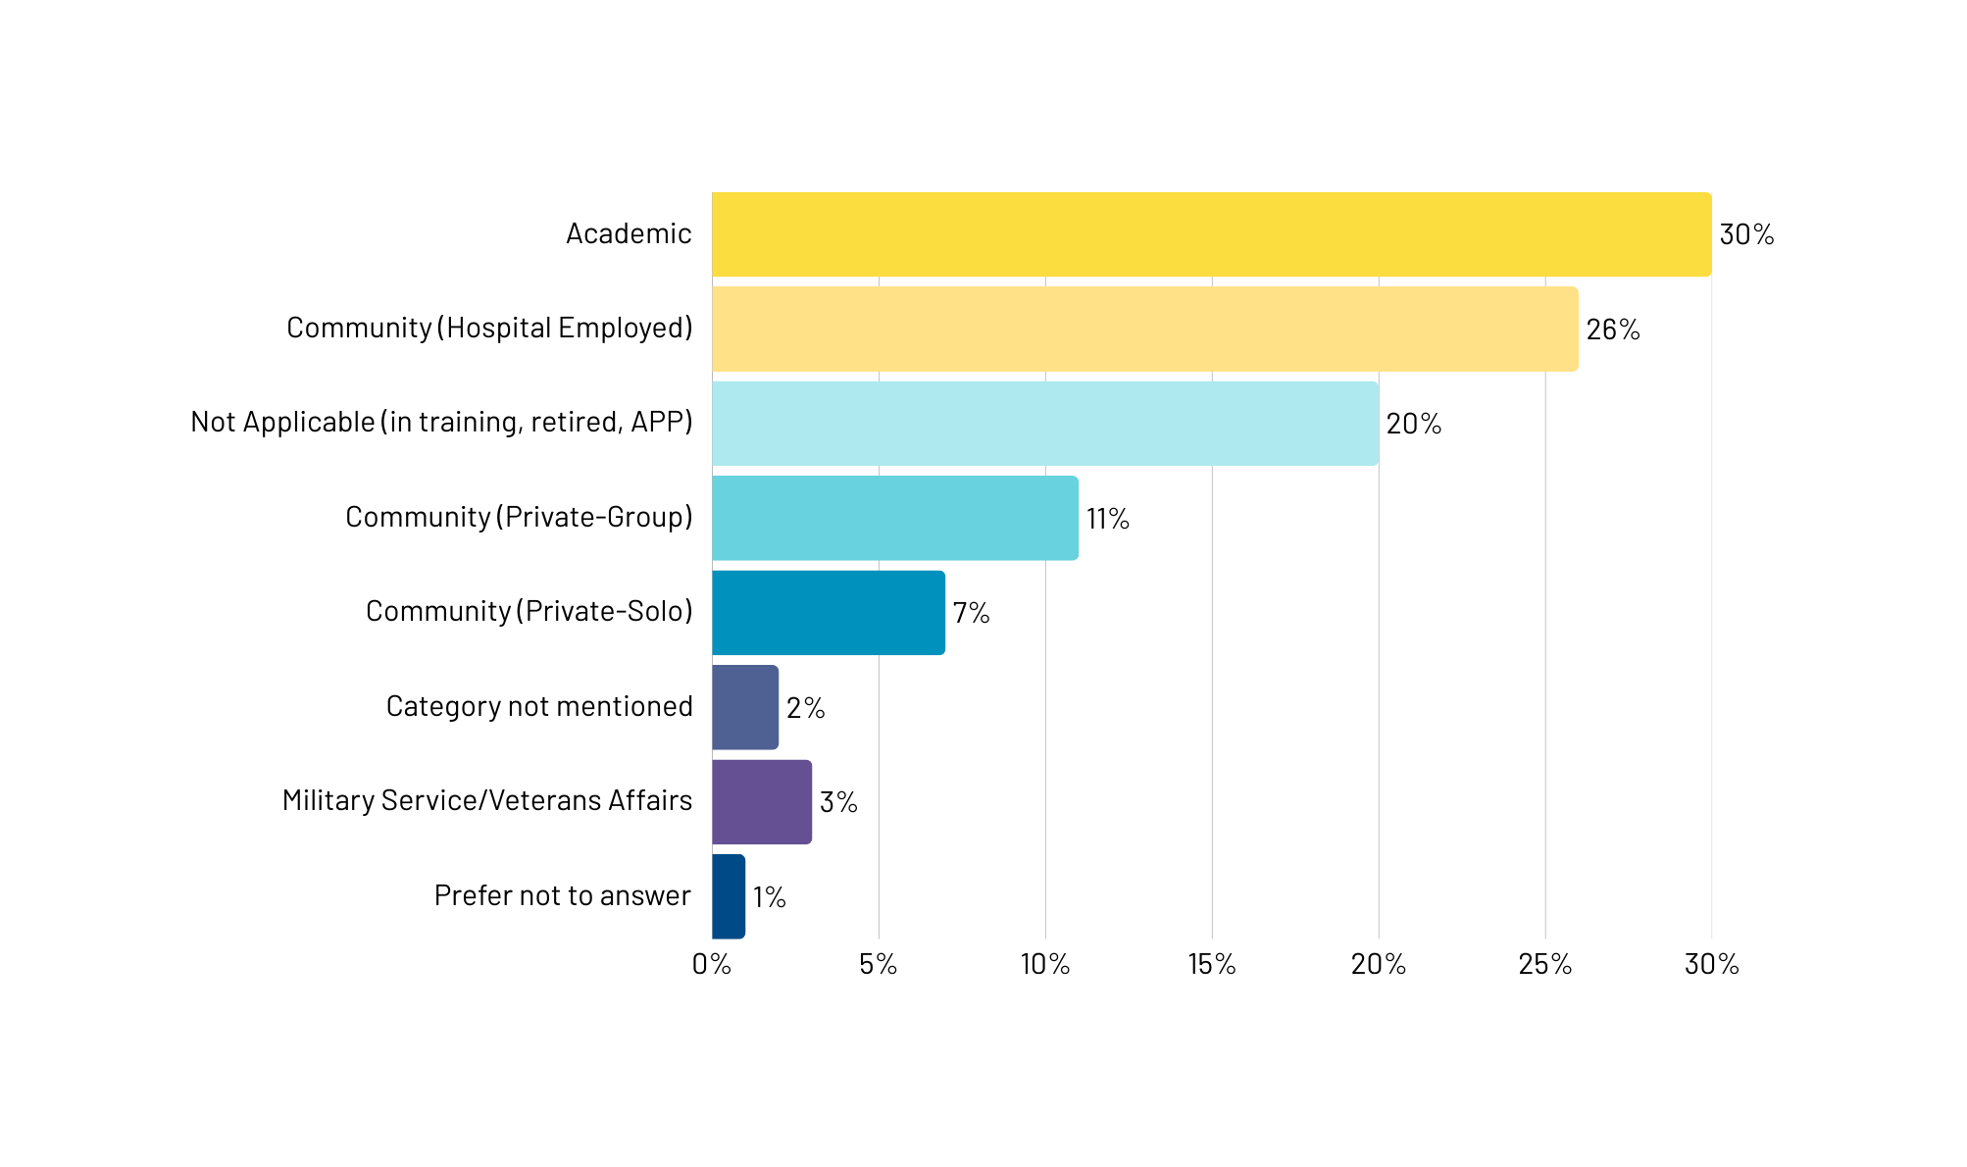
PRACTICE TYPE
Notes:
Since 2024, Academic dropped from 40% to 30%. Community (HE) grew from 22%, Not Applicable grew from 14%. All other categories within 1% of last year’s numbers.

Slide 3
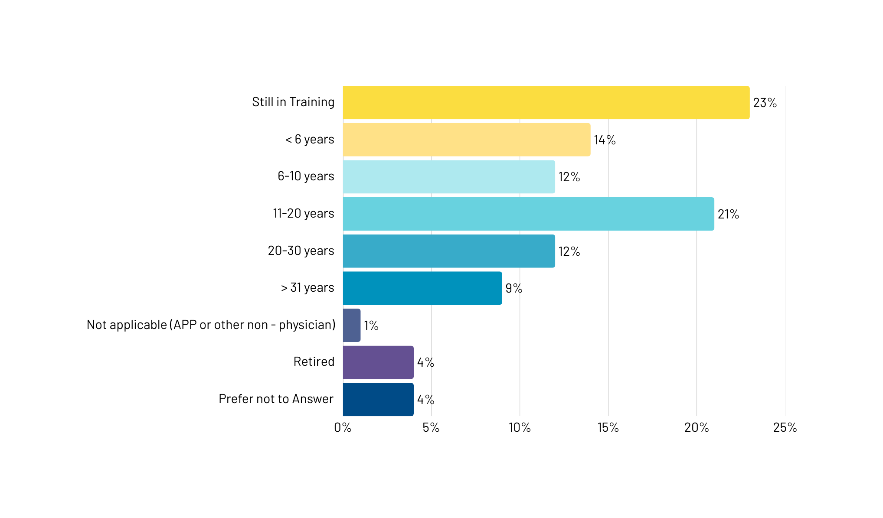
YEARS IN PRACTICE
Notes:
Since Sept. 2024, members Still in Training rose by 11%. Under 6 years decreased by 8%, 21-30 years decreased by 5%. N/a, retired, and PNTA in total grew to 9% from 3%.

Slide 4
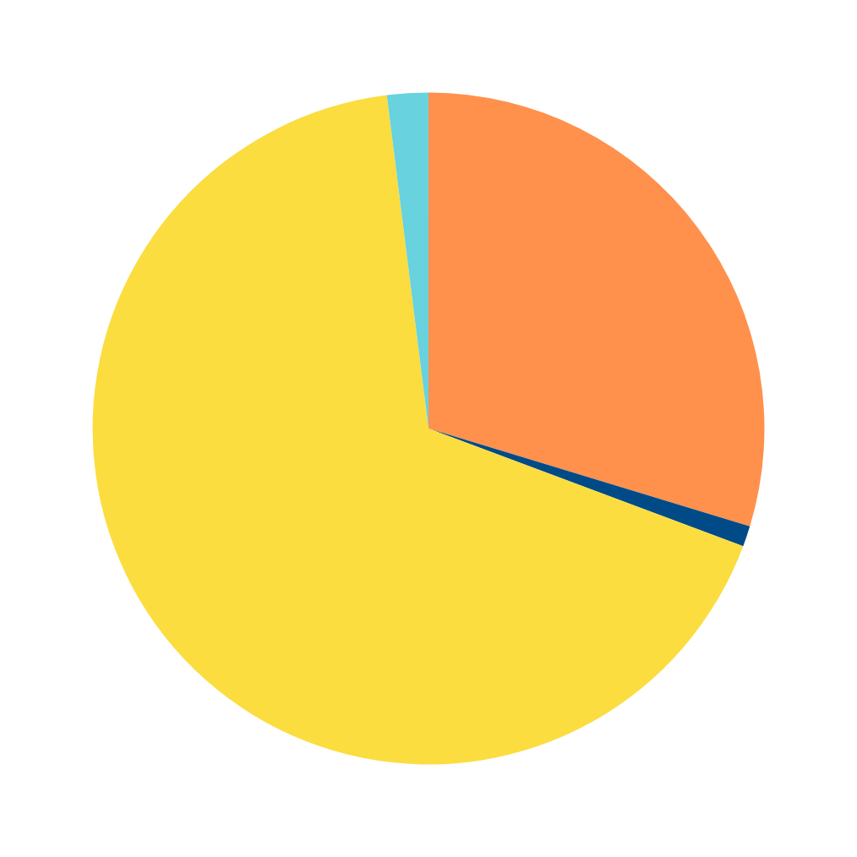
GENDER
2%
Male - 68%
Female - 30%
Prefer not to Answer - 2%
Nonbinary - <1%
30%
<1%
68%
Notes:
Almost identical % compared to Sept. 2024

Slide 5
GENDER IDENTITY
2%
Male - 68%
Female - 30%
Prefer not to Answer - 2%
Other - <1%
30%
<1%
68%
Notes:
Female increased 2%, while PNTA and Other each decreased by 1%

Slide 6
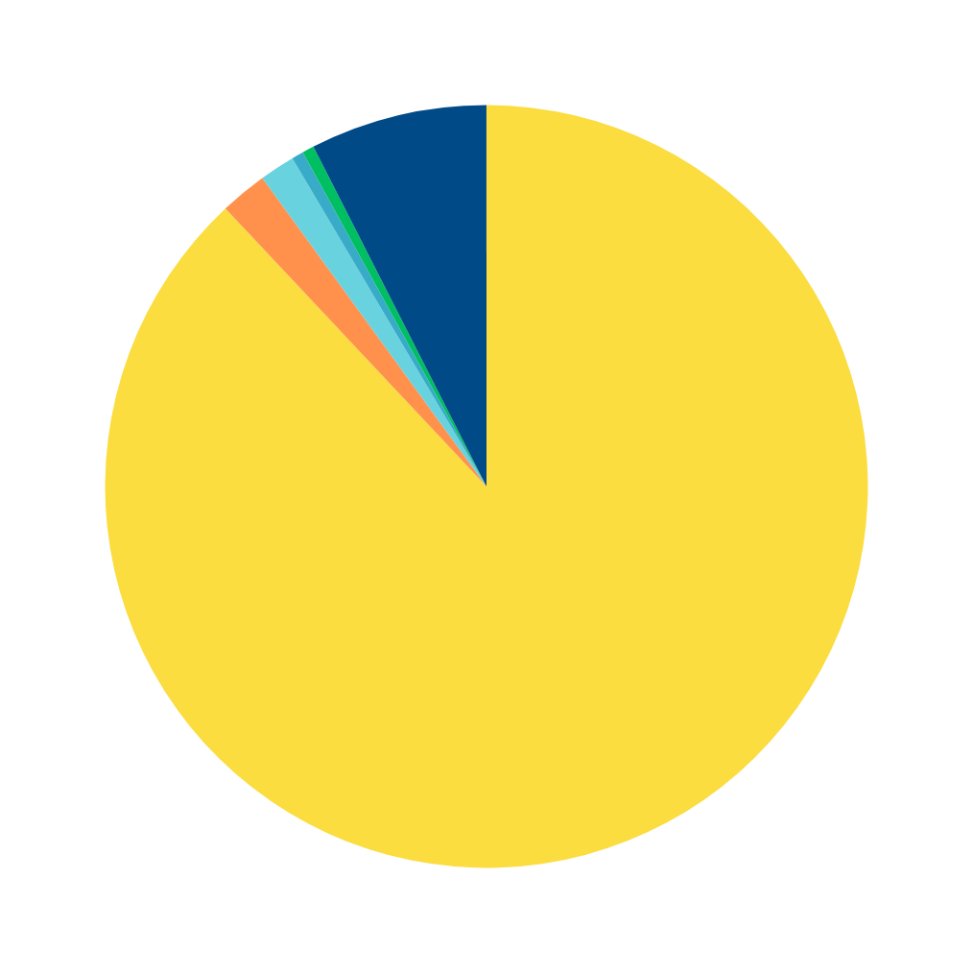
SEXUAL ORIENTATION
<1%
1.5%
Straight/Heterosexual - 89%
Gay/Lesbian/Homosexual - 2%
Bisexual - 1.5%
Asexual - <1%
Other - <1%
Prefer not to Answer 7.5%
7.5%
2%
89%
Notes:
Straight/Hetero decreased by 1%, PNTA increased by 2%, miniscule changes otherwise.

Slide 7
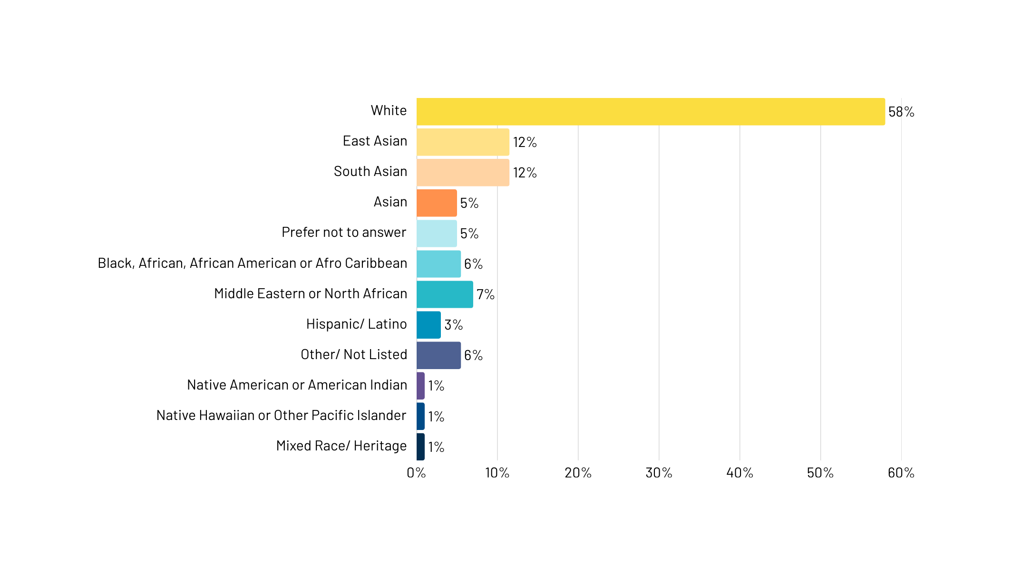
RACE
11.5%
11.5%
5.5%
5.5%
<1%
<1%
<1%
Notes:
NOTE: respondents could select more than 1 answer. Since 2024, East Asian and South Asian both increased by 4%, MENA and Other both increased by 2%. Others only tiny changes up or down.

Slide 8
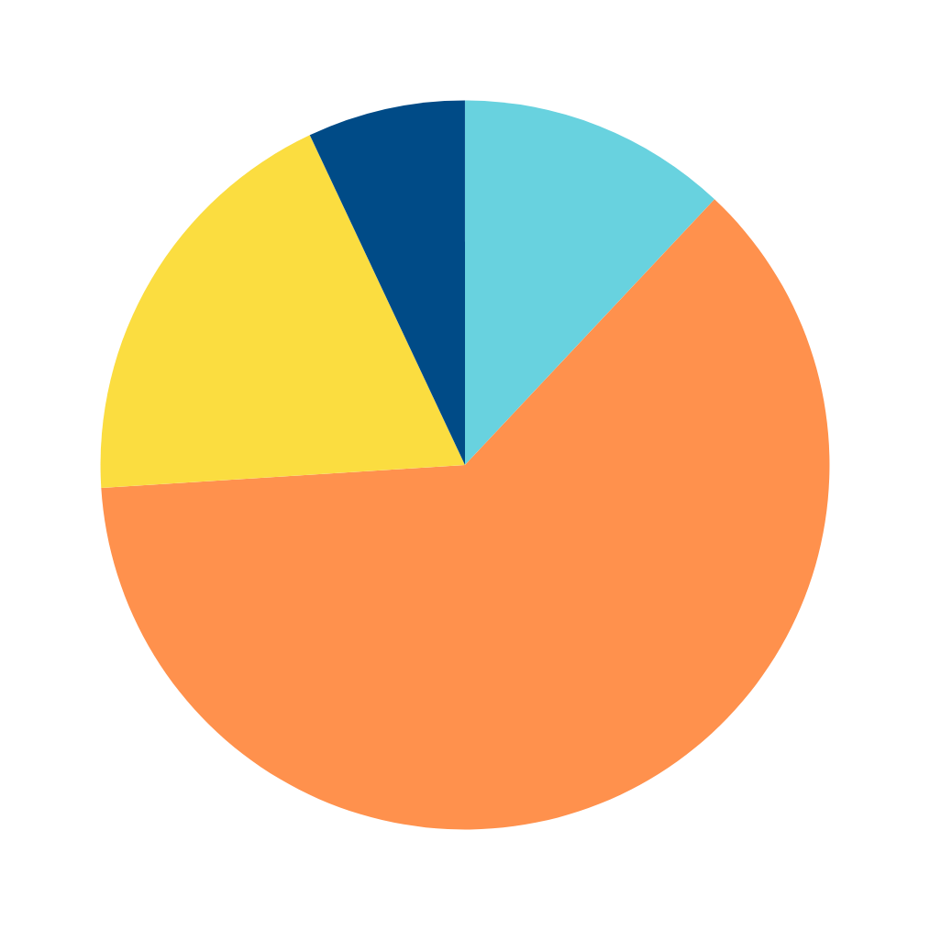
ETHNICITY
7%
19%
Hispanic/LatinX - 12%
Non-Hispanic/LatinX - 62%
Other - 19%
Prefer not to Answer - 7%
12%
62%
Notes:
Hispanic/Latinx increased by 4%, NonHispanic decreased by 3%, Other increased by 10%, PNTA decreased by 11%.

Slide 9
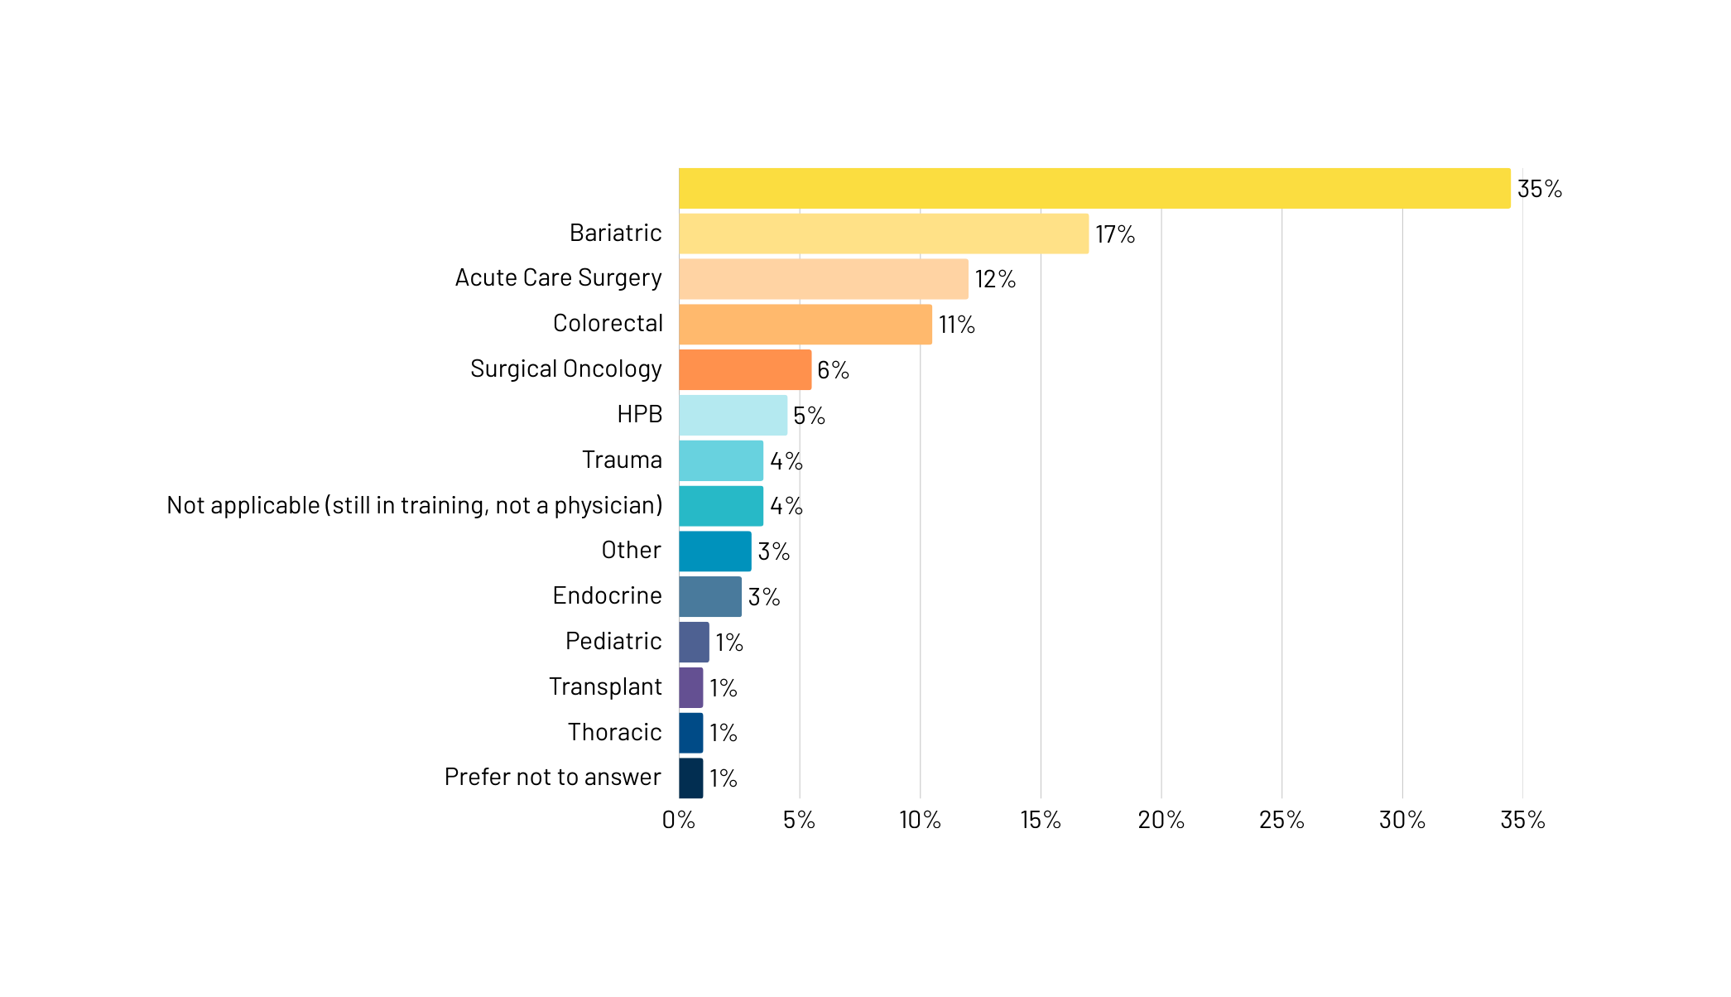
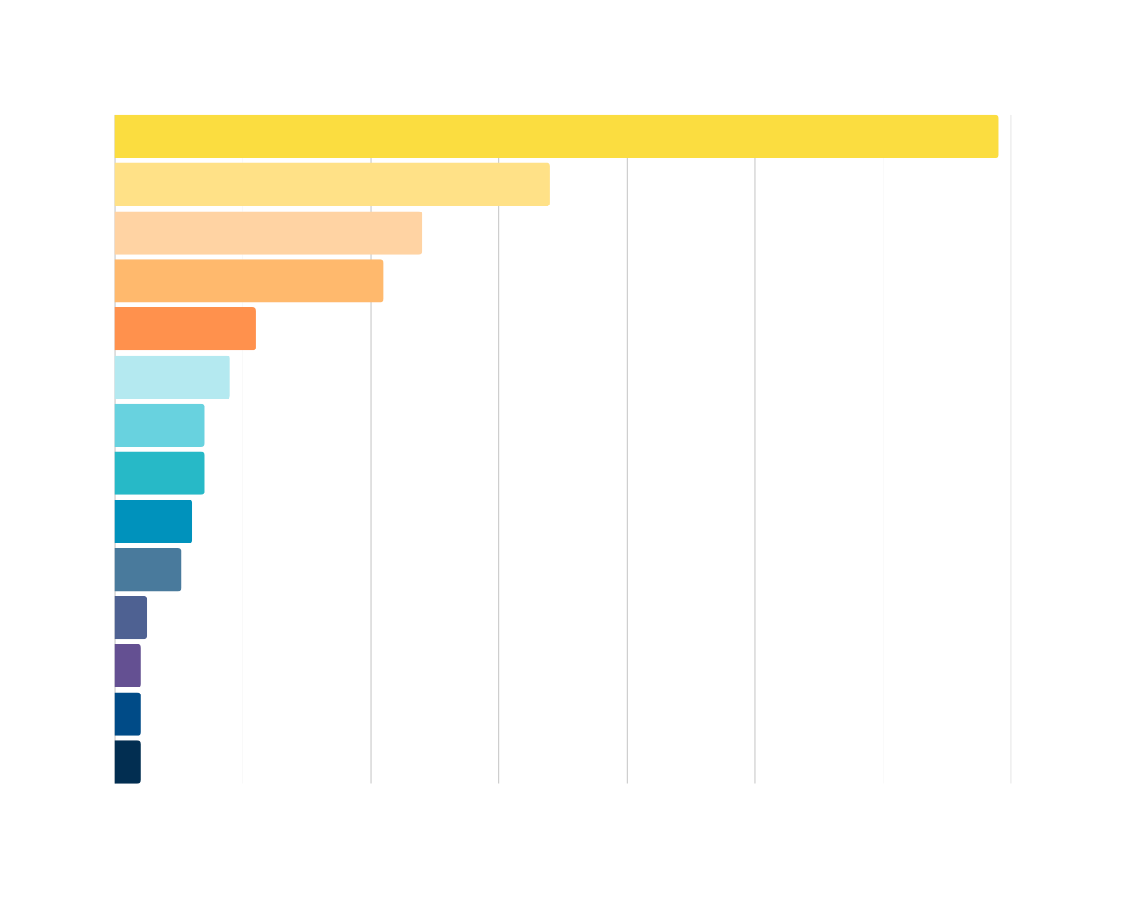
SPECIALTY
General/MIS (includes Foregut, Flexible Endoscopy, Hernia)
34.5%
10.5%
5.5%
4.5%
3.5%
3.5%
2.6%
<1%
<1%
<1%
Notes:
NOTE: respondents could select more than one answer. All categories decreased or increased by less than 1% - exceptions are General decreased by 1.5% and Other which increased by 2%

